Slide 3
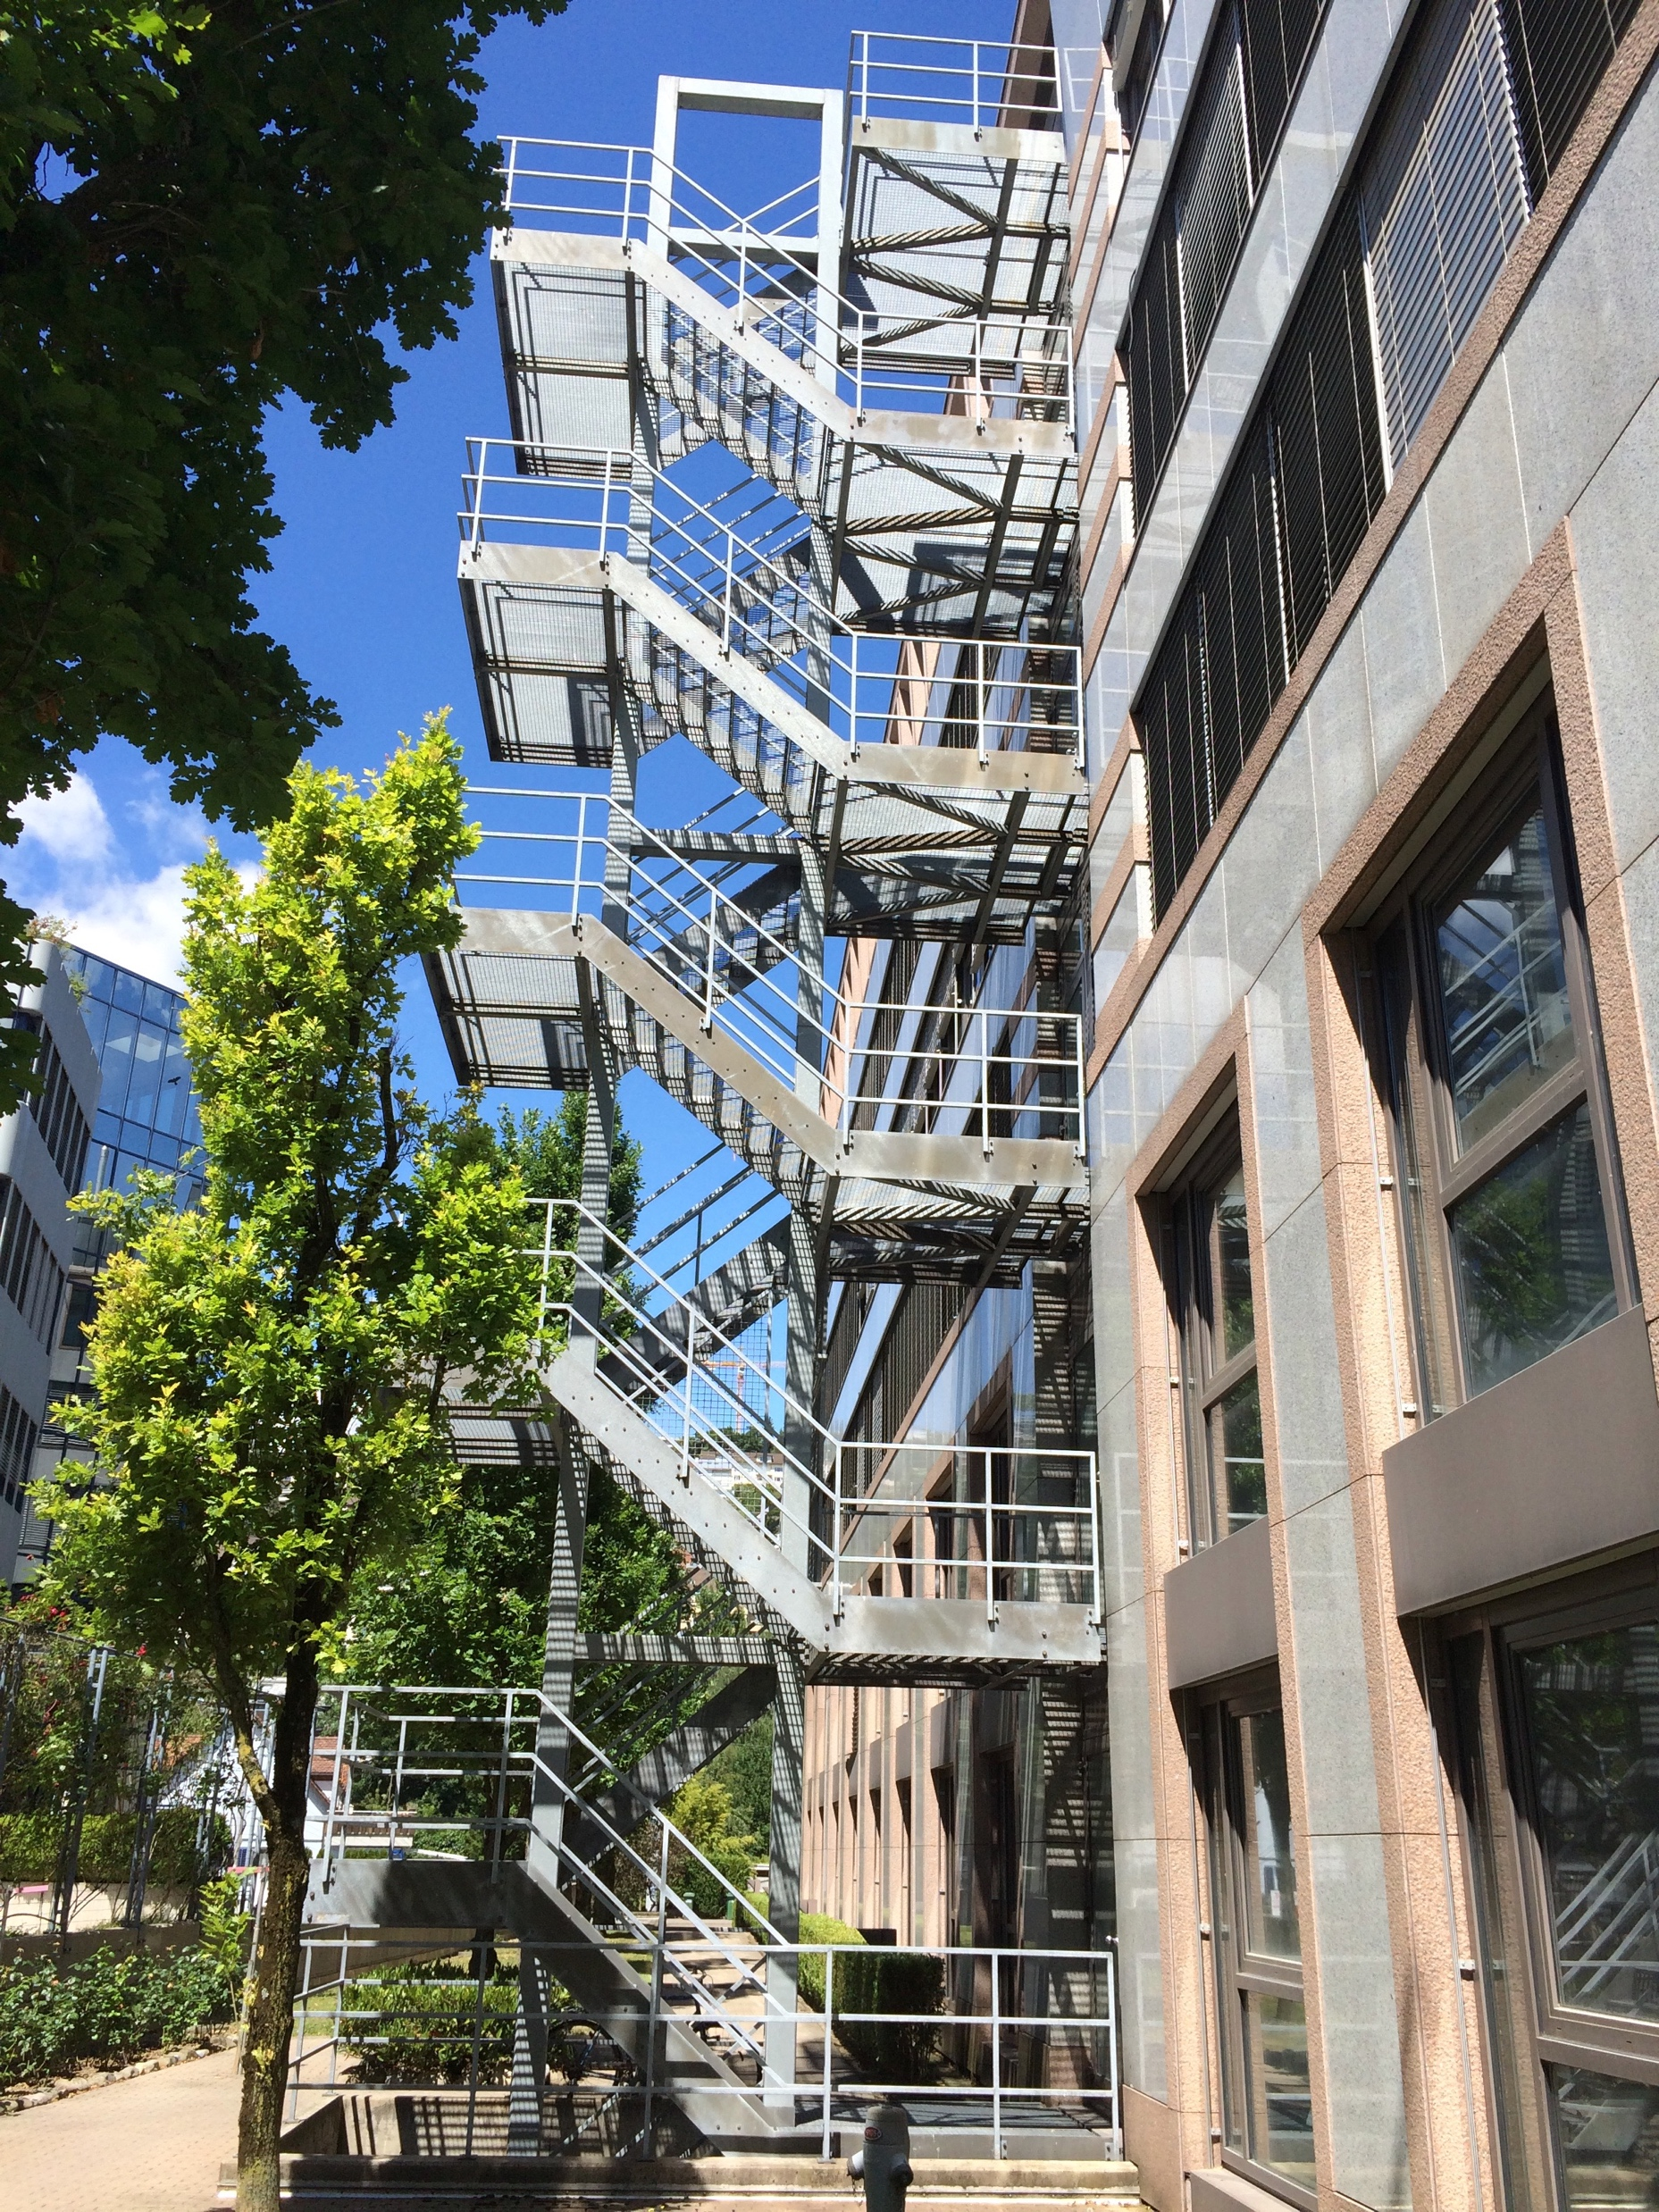
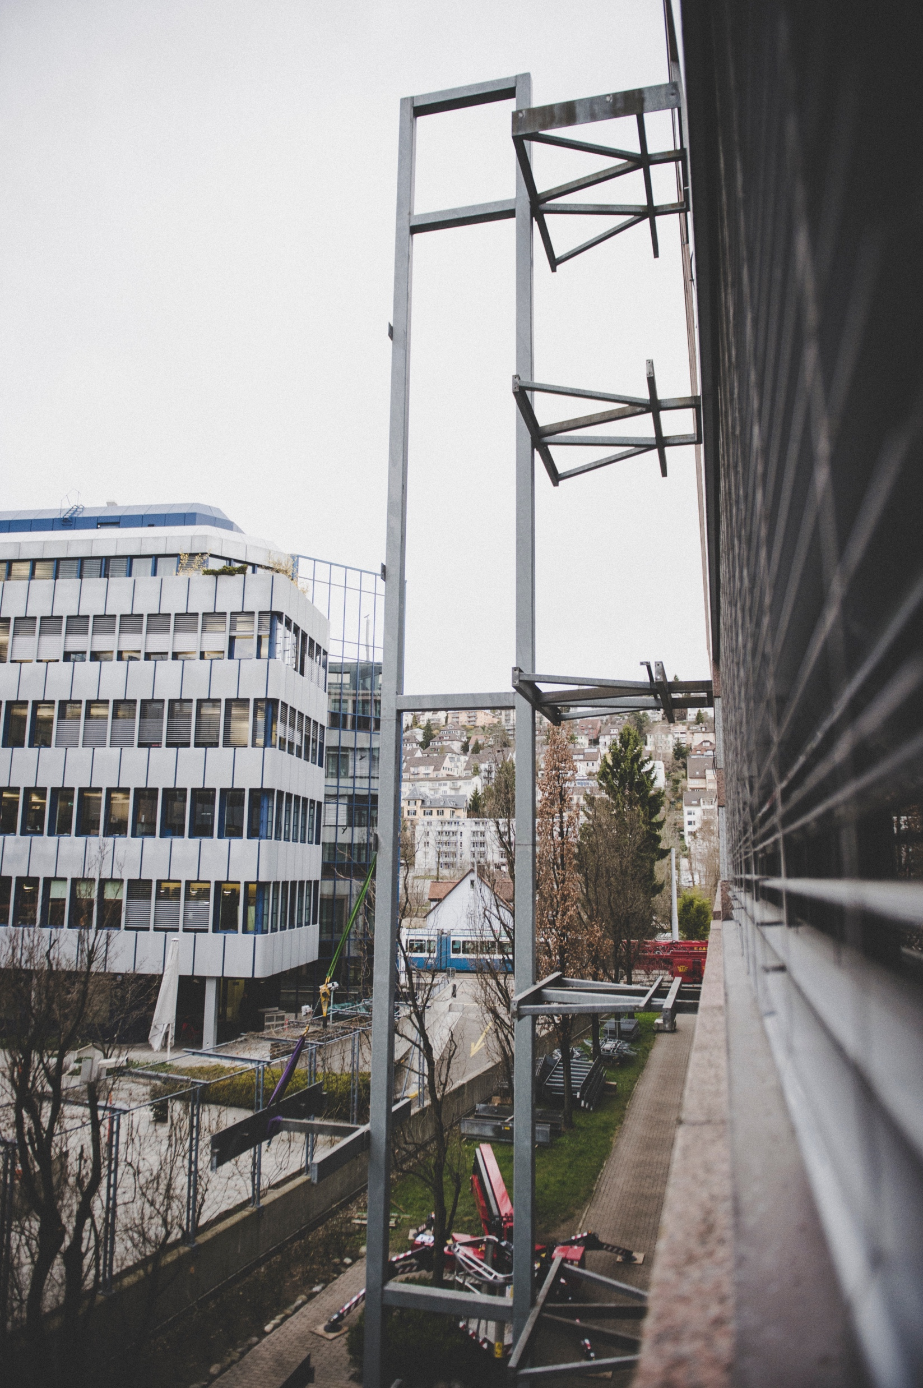

Slide 4
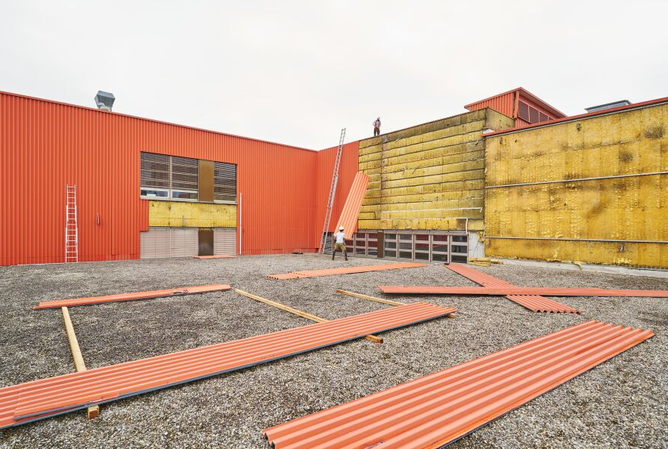

Slide 5
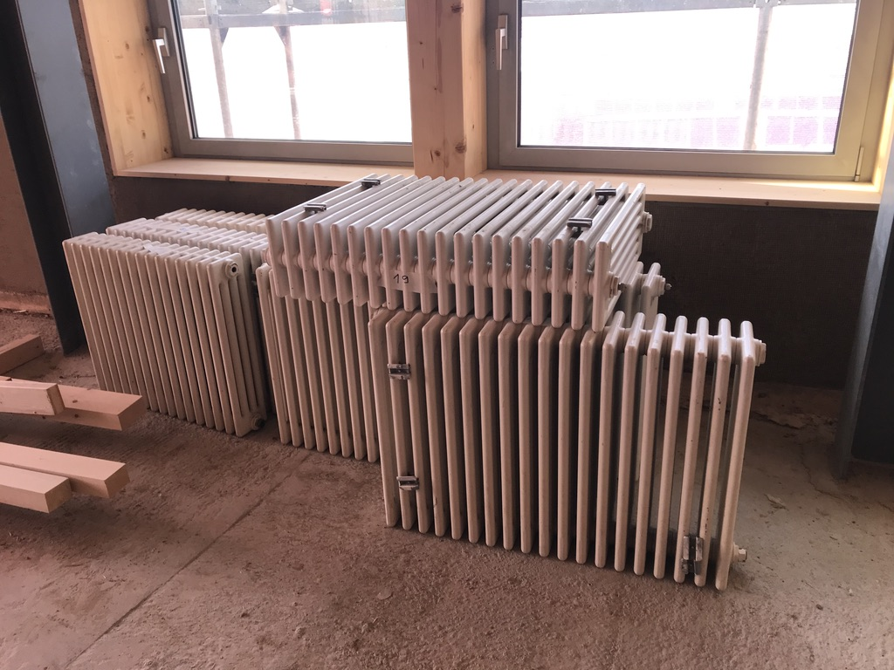

Slide 6
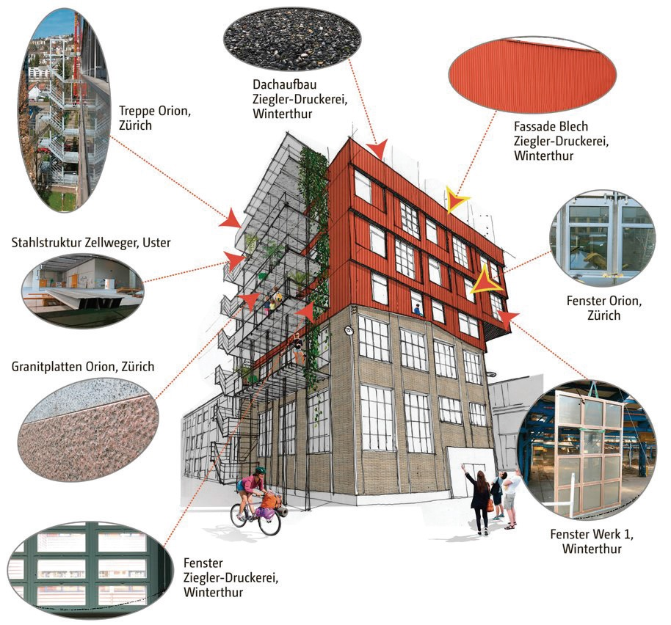
K118 WINTERTHUR Machbarkeitsstudie 2
Notes:
We didnt know what we find:
We found everything, staircases, facades, windows, granit stone, a whole roof assembly.

Slide 7
