Slide 1
die 5 R’s der Kreislaufwirtschaft:

Slide 2
REFUSE
Notes:
Lets talk about refuse first. Refuse does not cost any money → it might lead to lower honoraries of us architects.
Be strong

Slide 3
David Vaner und die BKB
Notes:
David Vaner, David against giant Goliath, David against the BKB Swiss local bank
Analized the facade – it was intact, maybe al little bit dirty.

Slide 9
Notes:
Dare to REFUSE useless construction, unnecessary replacements, and your client will even safe money!

Slide 10
REDUCE
Notes:
The next topic is REDUCE

Slide 11
Philippe Block Professor ETH „Strenght through geometry!“

Slide 12
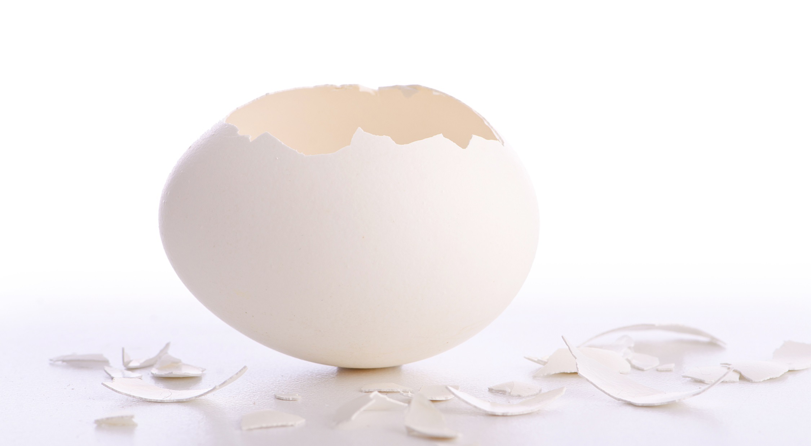
Notes:
The next concept is REDUCE

Slide 17
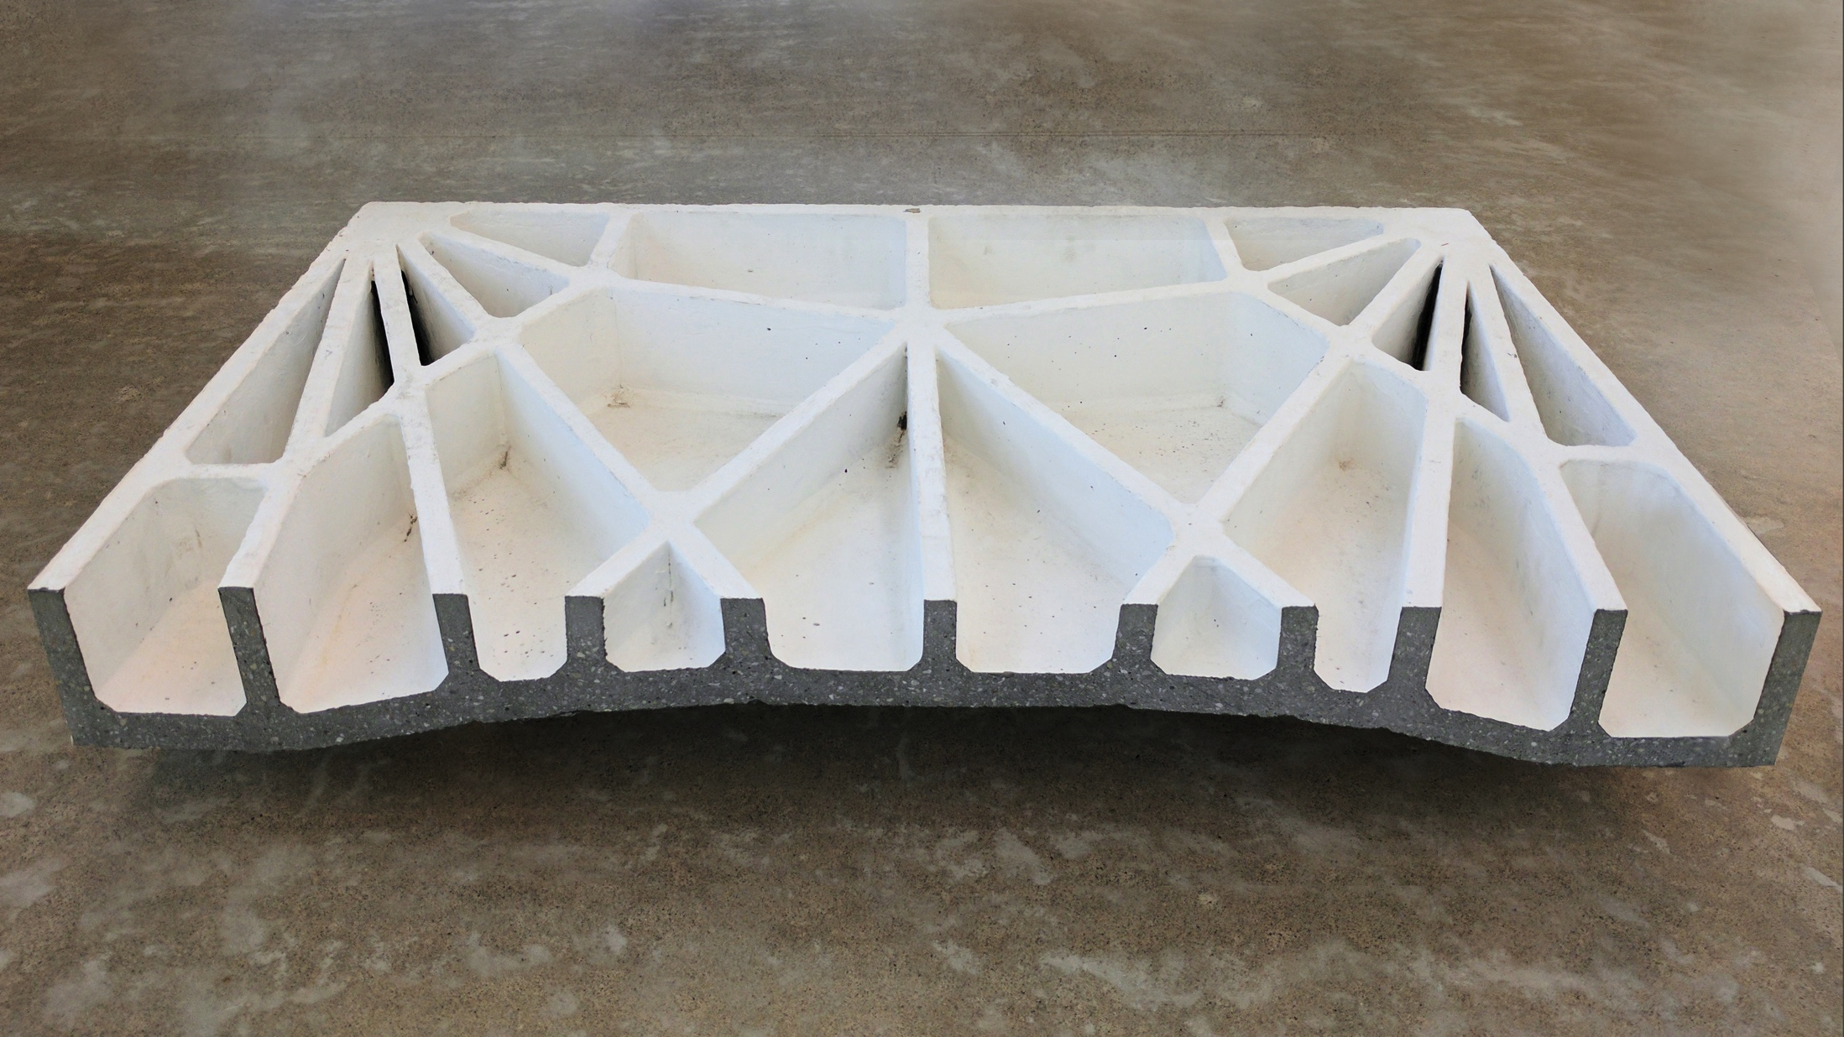
Notes:
70% concrete rippman roof construction
90% steel

