Slide 1
Notes:
Shuttering formwork casing

Slide 2
Notes:
Metal shetts for shuttering of the concrete floors

Slide 3
Notes:
Floors made from recycling concrete

Slide 5
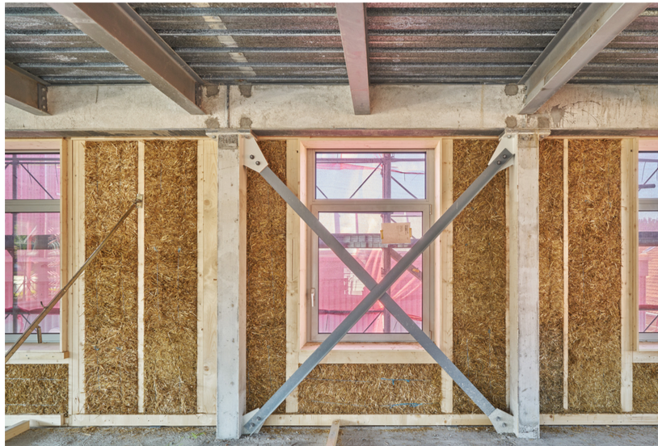

Slide 6
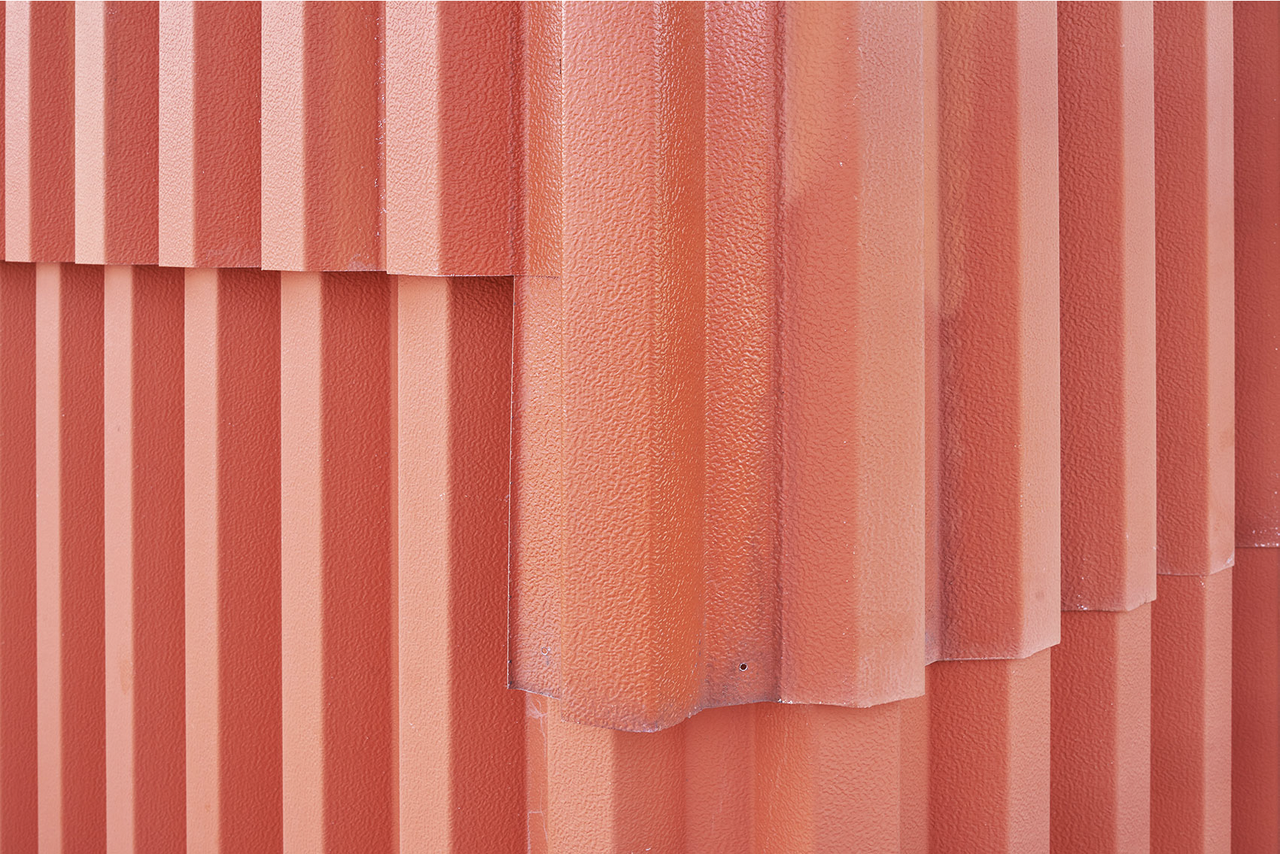

Slide 7
