Slide 1
REINVENT
Notes:
To build with natural renewable materials:
look back into your history, into your roots, and you will find a rich heritage
Specially in Portugal:
Construcoes em Terra, adobe, taipal,
Isolalations with cork, wool, grass
It‘s all there!!!!!

Slide 6
Notes:
Roger Boltshauser

Slide 7
Notes:
Wool

Slide 8
Notes:
Flax or Linum

Slide 10
Saikal Khunoshova

Slide 13
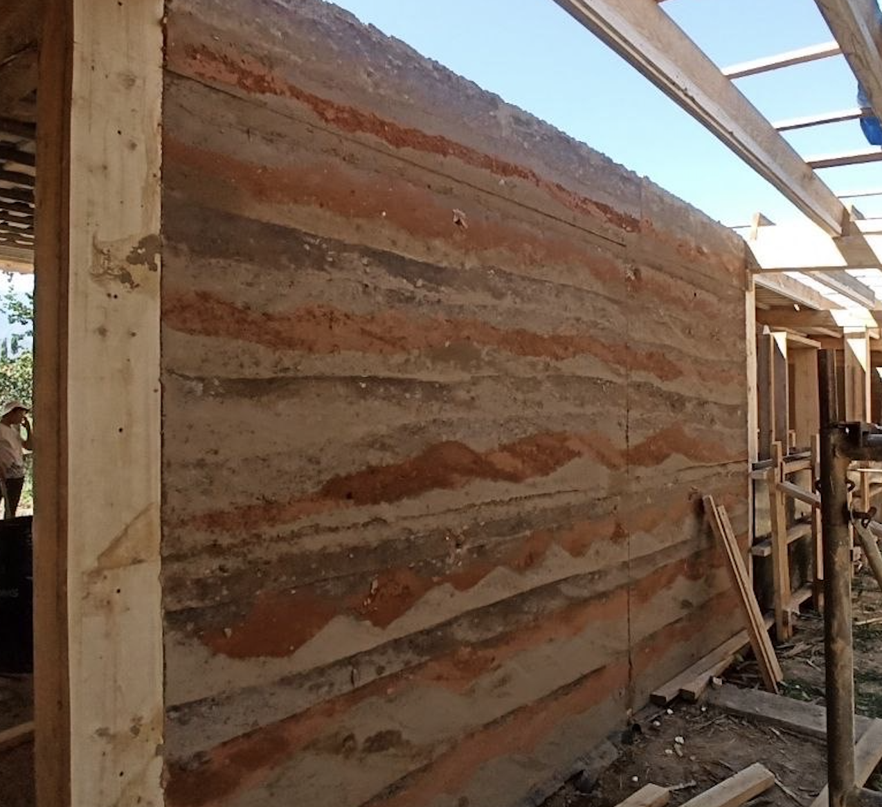
Notes:
Rammed earth construction

Slide 14
