Slide 1
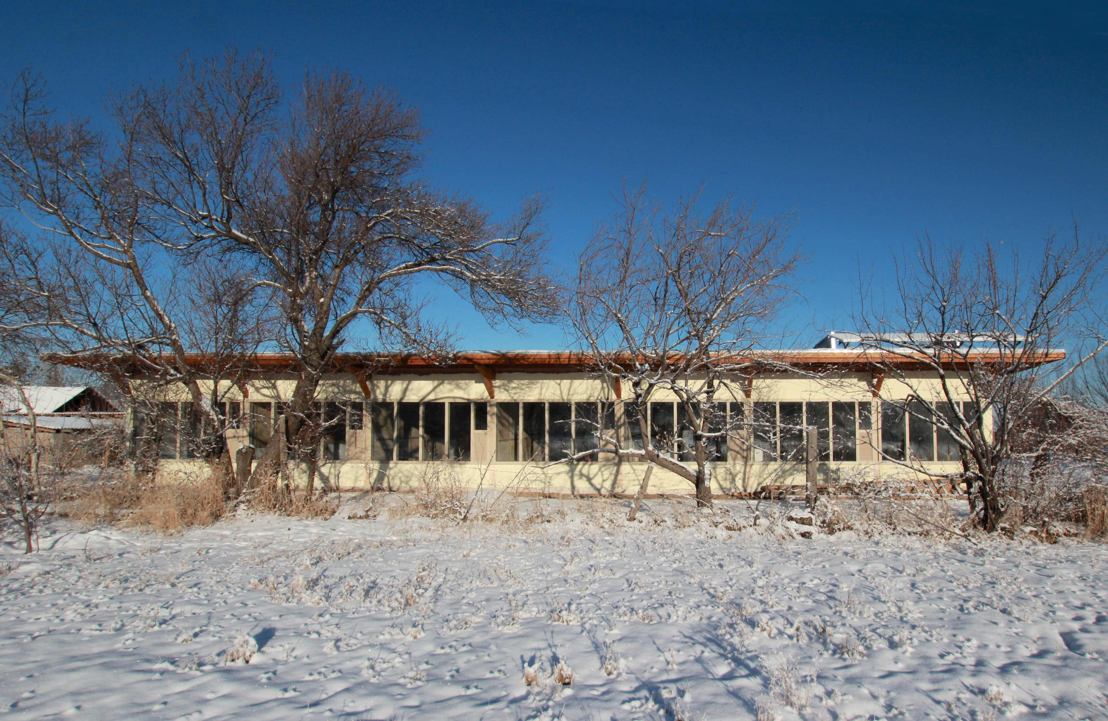

Slide 2
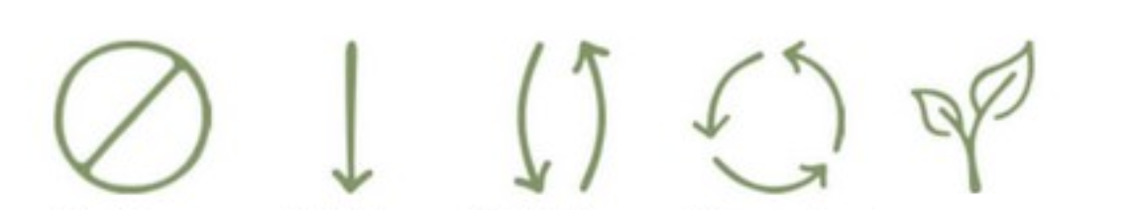
refuse reduce reuse recycle reinvent
JETZT!
Notes:
REFUSE: scrutinize the task given to you.
Dare to oppose the client,
be strong! Stay independent!
REDUCE: optimise material use rather than the use of time or money,
challenge the task
REUSE: get inspired by the existing, the richness, the plenitude the material you find in situ, be imaginative, be inventive!
RECYCLE: only if there is no other possibility, you can even move buildings instead of demolishing them – the Swiss engineers will be happy to help you
REINVENT: remember your traditions – specially here in Portugal -
go further! Now!!!!
That is the key message I want to give you for the two coming daya!

Slide 3
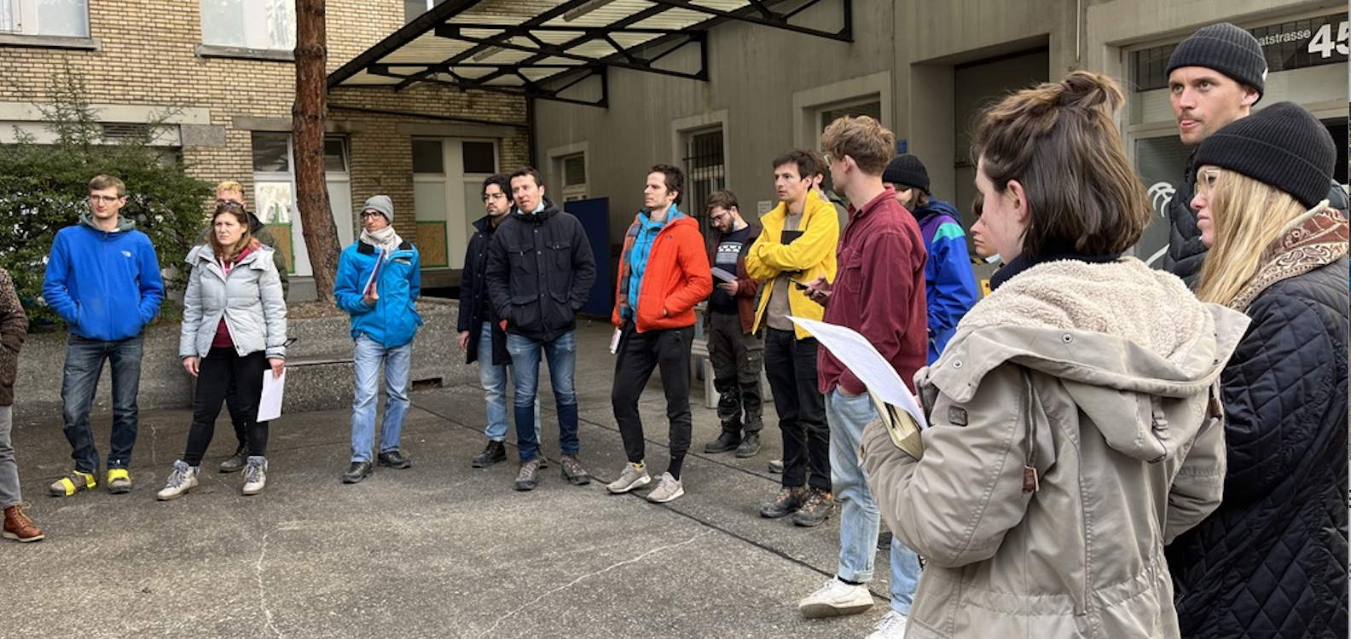
2022 ETH Entwurfssemester „selon arrivage“

Slide 4
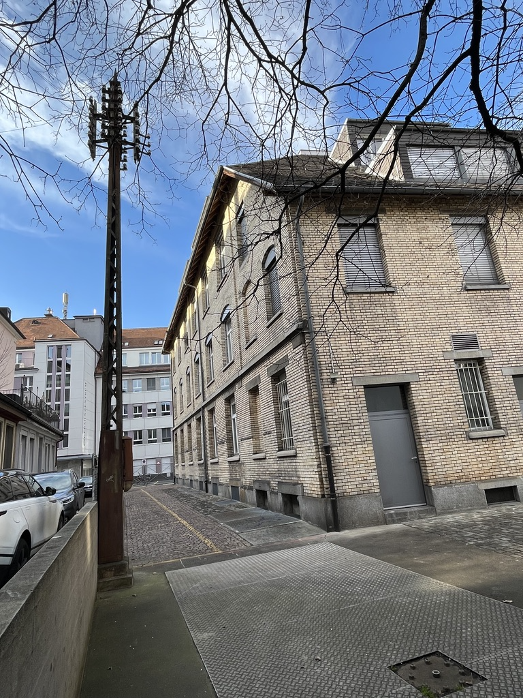
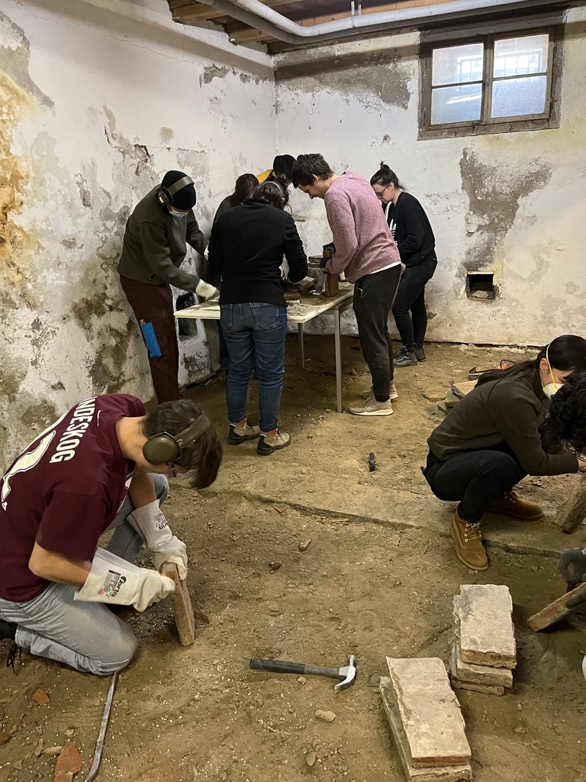

Slide 5
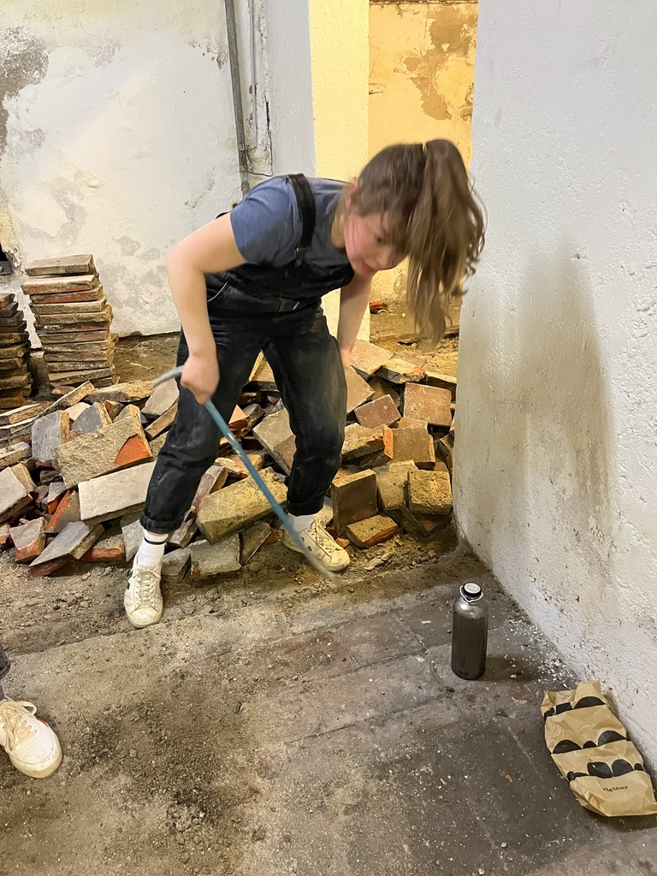
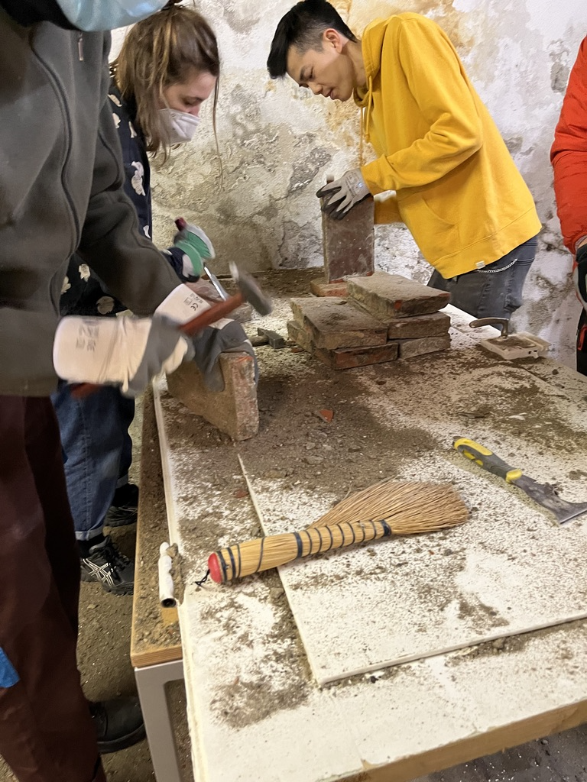

Slide 6
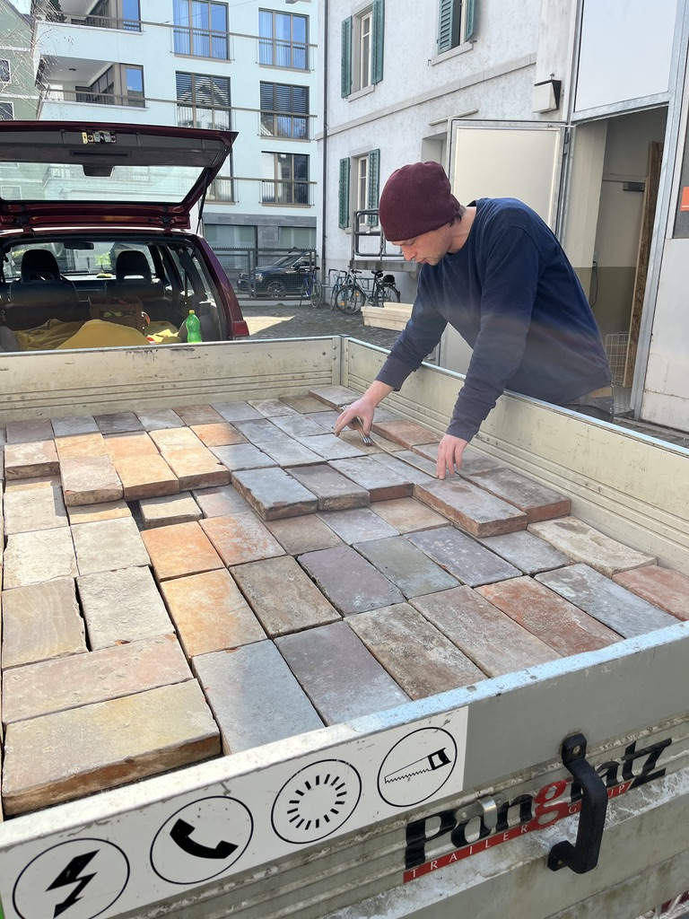
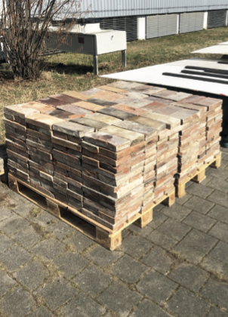

Slide 7
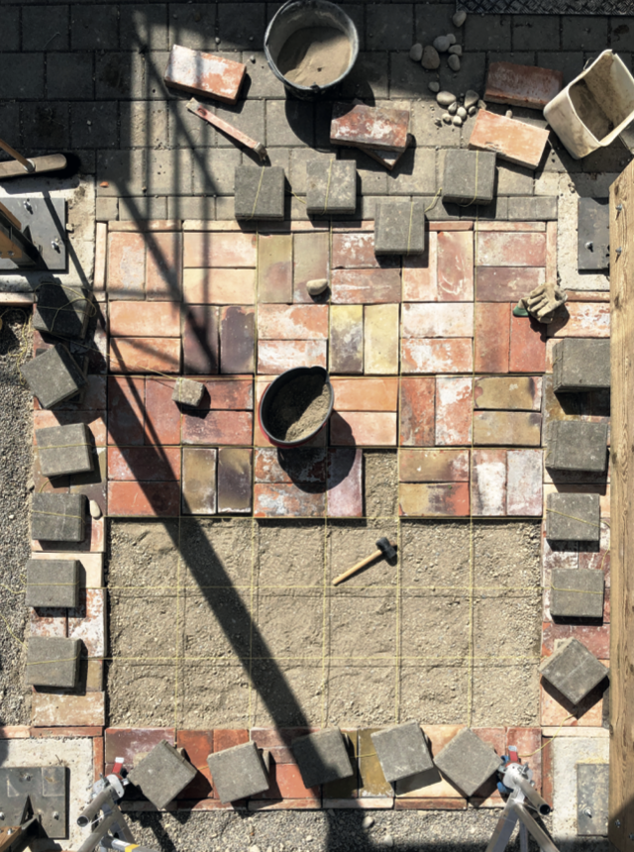


Slide 8
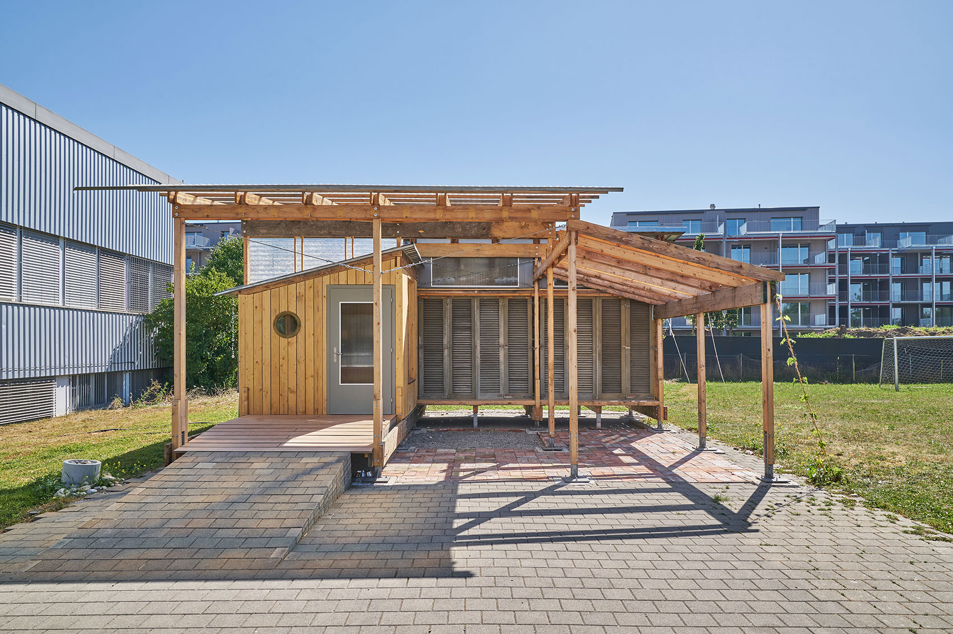

Slide 9
