Slide 1
REUSE

Slide 2
K.118 Lagerplatz Winterthur

Slide 3
?

Slide 4
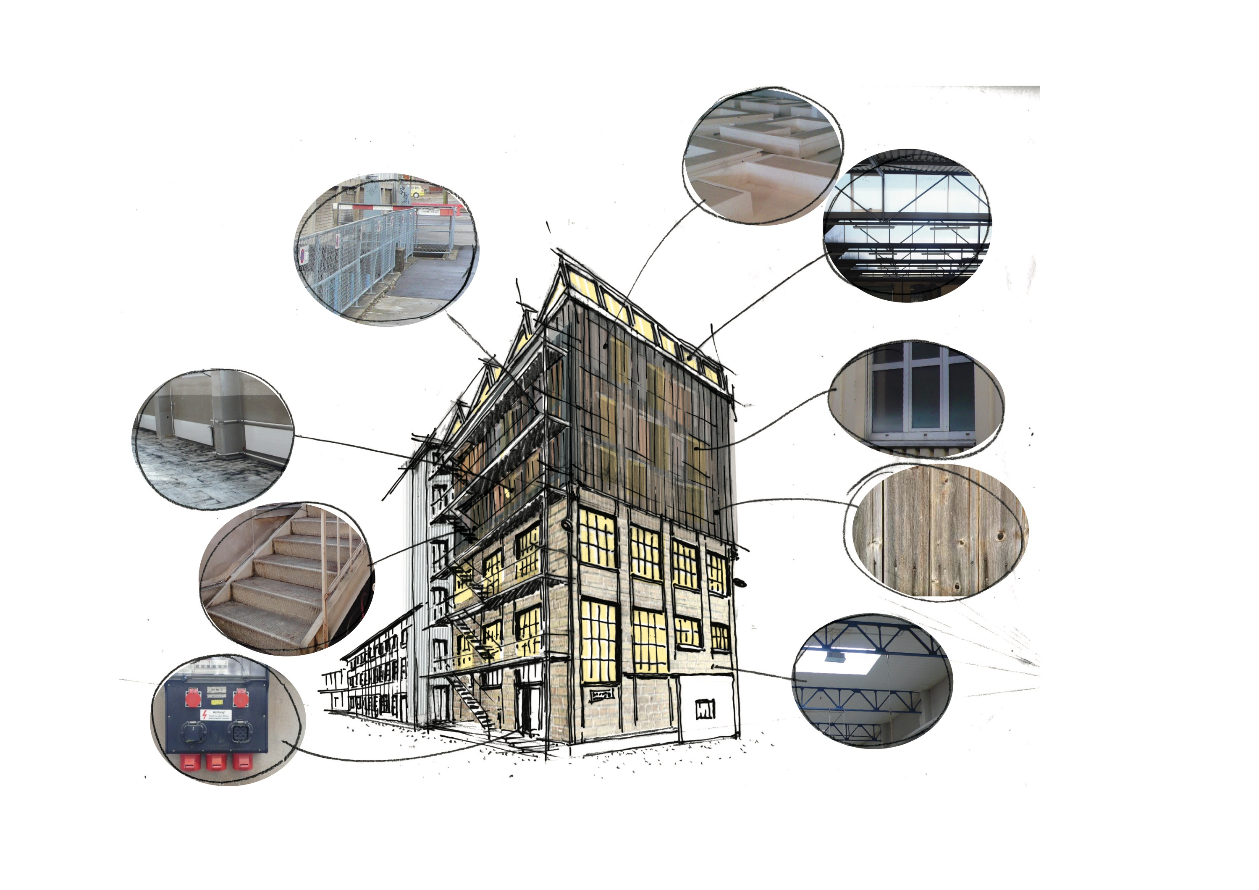
K118 WINTERTHUR
Machbarkeitsstudie 1
K 118 | Laufend
Notes:
We didnt know what we find:
We found everything, staircases, facades, windows, granit stone, a whole roof assembly.

Slide 6
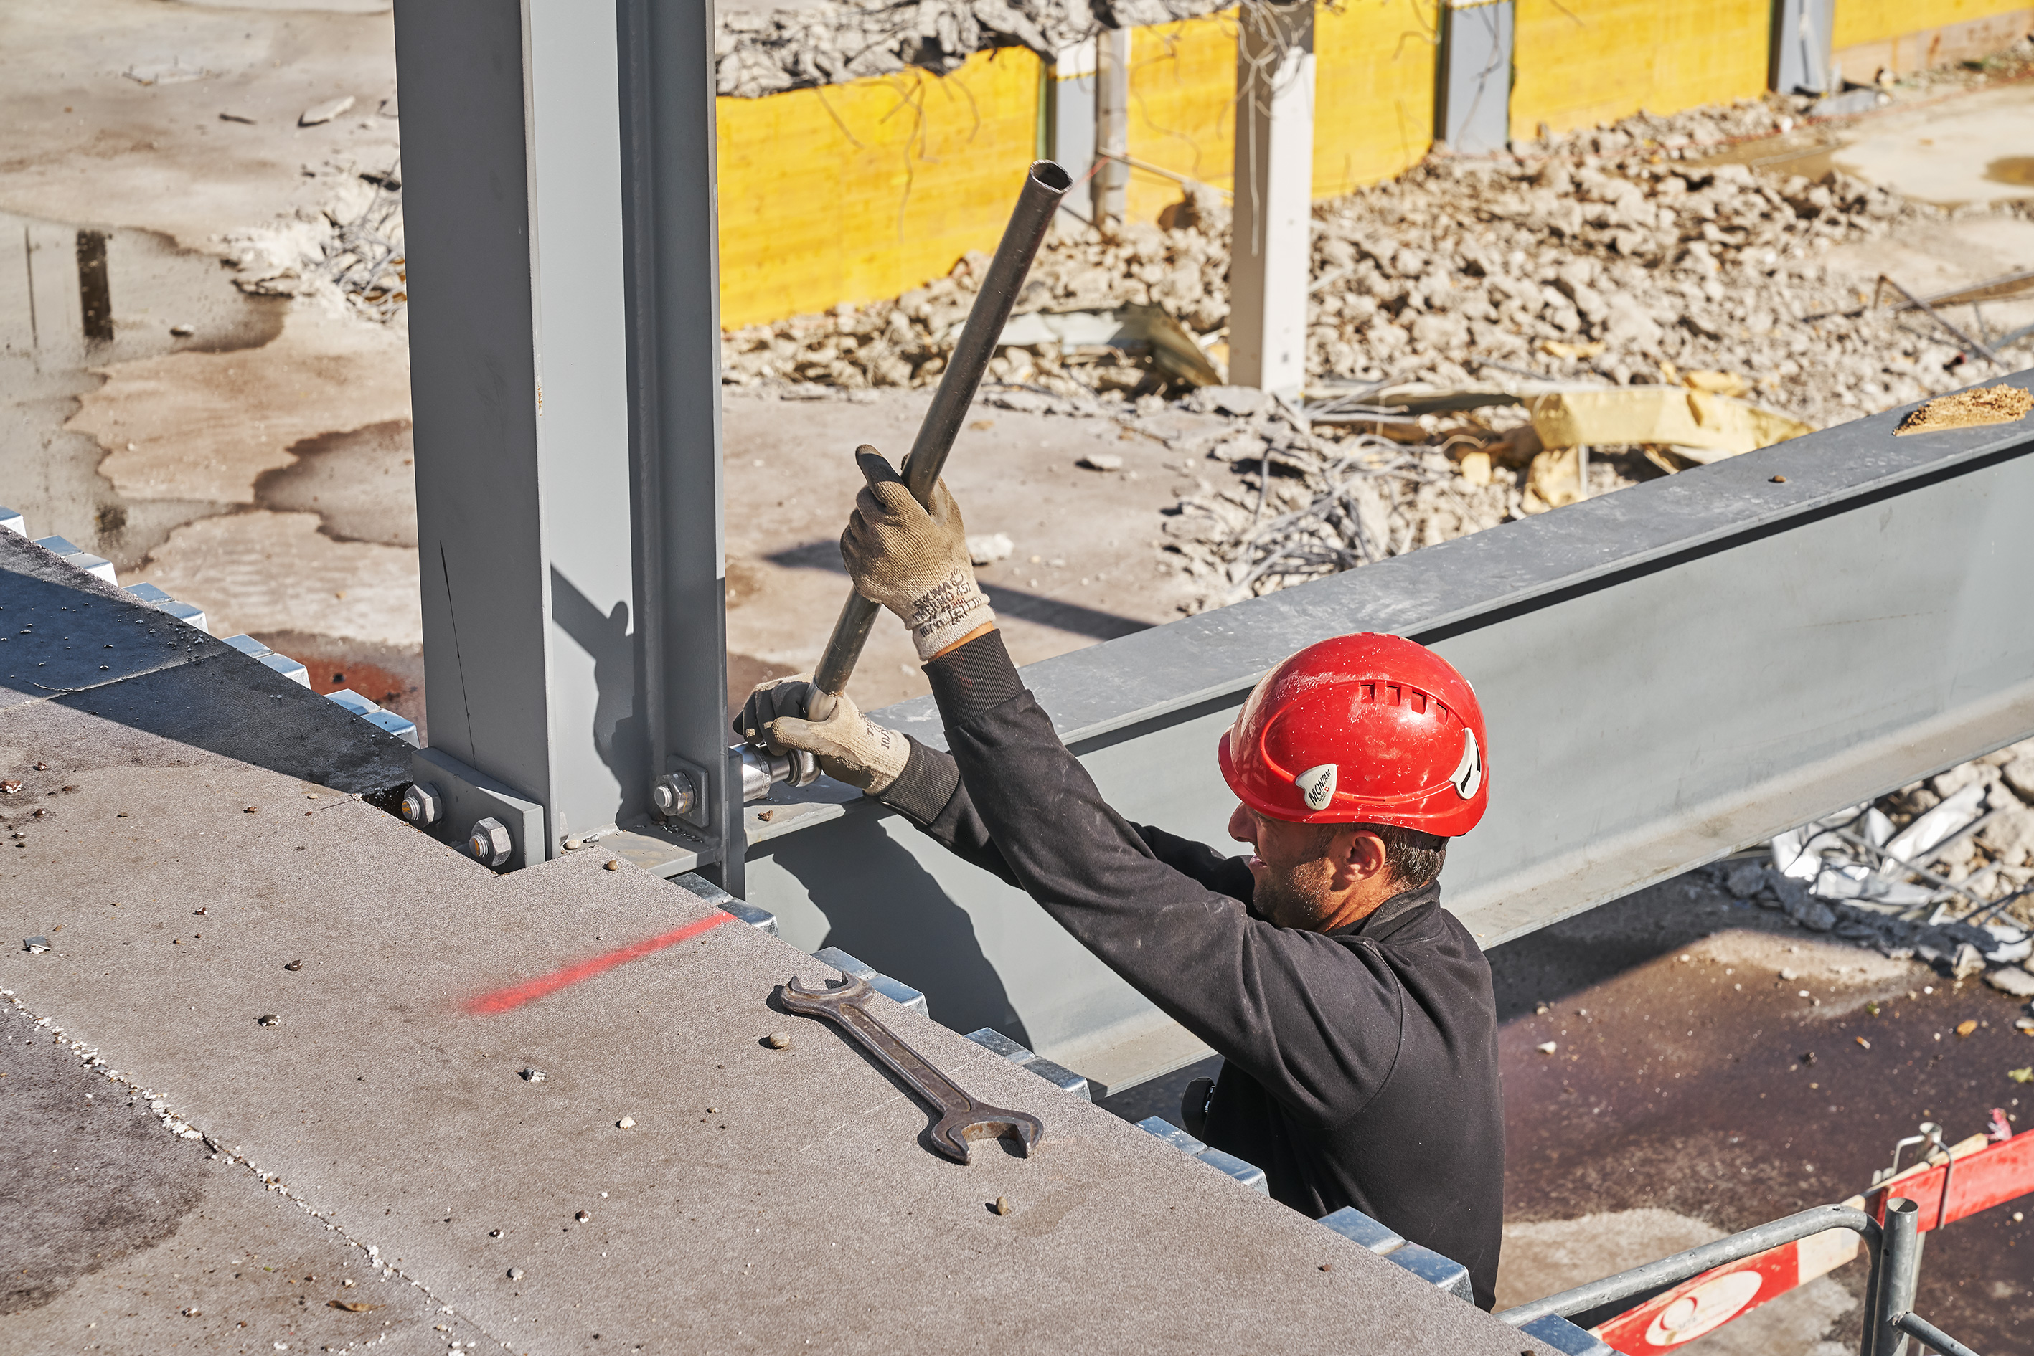

Slide 8
